Slide 1
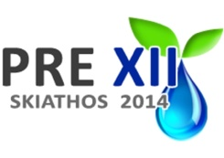
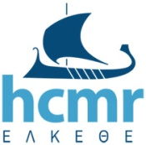
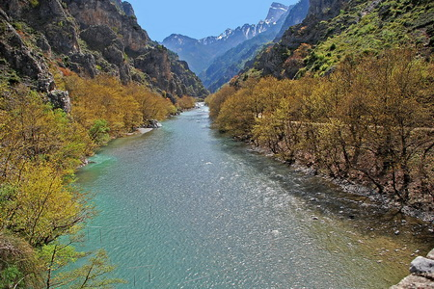
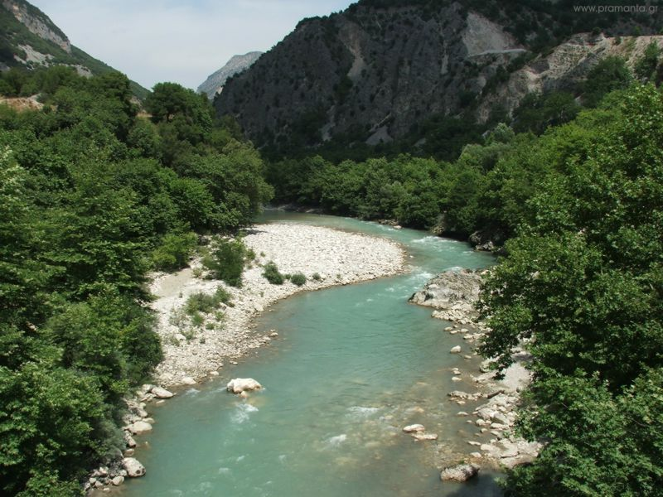
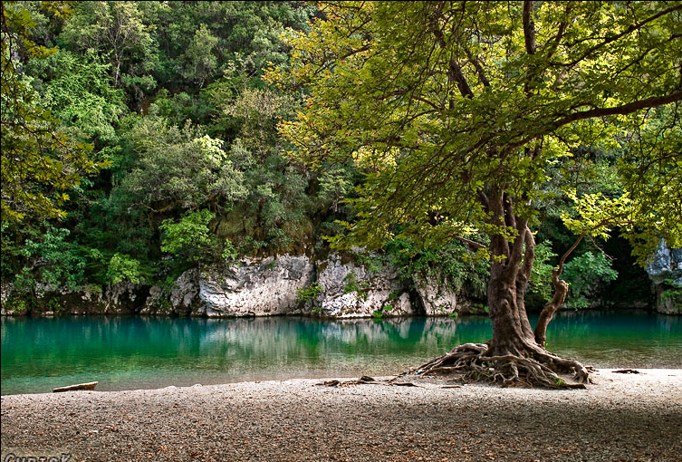
European Regional Development Fund
Habitat hydraulic modelling for environmental flow restoration in upland streams in Greece
Ch. Papadaki¹, L. Ntoanidis², S. Zogaris¹, F. Martinez-Capel³, R. Muñoz-Mas³, N. Evelpidou⁴ and E. Dimitriou¹
^{1,}Hellenic Centre for Marine Research, Institute of Marine Biological Resources and Inland Waters, 46.7 km, Athens - Sounio Ave., 19013, Anavissos, Greece,
²D. Argyropoulos & associates, Tinou 2, 15562 Cholargos, Greece,
^{3,} Research Institute for Integrated Management of Coastal Areas, Universitat Politècnica de València. C/ Paranimf 1, 46730 Grau de Gandia. Valencia. España,
⁴Faculty of Geology and Geoenvironment, National and Kapodistrian University of Athens, Panepistimiopolis, 15784 Athens, Greece
Habitat hydraulic modelling for environmental flow restoration in upland streams in Greece
July 2014

Slide 2
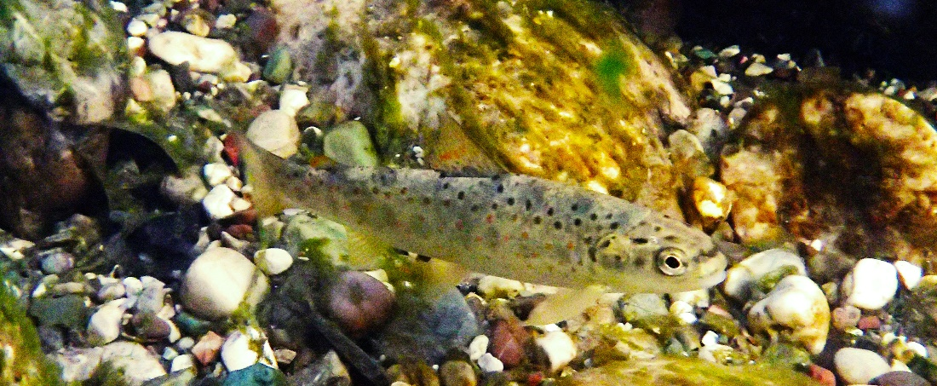
The aim of this study
Apply a state-of-the-art methodology for the estimation of environmental flows by predicting how different in-stream flows affect fish microhabitats
Why fish?
Jowett 1992,
Jager et al. 1993,
Nehring and Anderson 1993,
Railsback et al. 1993,
Bovee et al. 1994,
Stalnaker et al. 1995,
Studley et al. 1995
Aquatic species react to changes in the hydraulic environment
EU Water Framework Directive (WFD)

Slide 3
Basic elements of the study
was used to determine characteristics of the stream,
in terms of depth and velocity, as a function of discharge
integrated with the hydraulic model to produce a measurement for available habitat
as a function of discharge
Hydraulic model
One-dimensional -HEC RAS
Habitat Suitability Criteria Curves
originally integrated in the
Instream Flow Incremental methodology (IFIM)

Slide 4
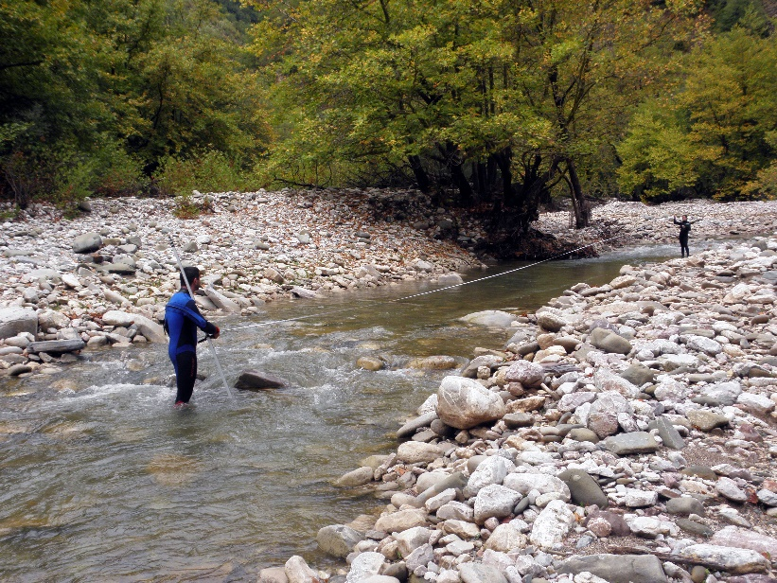
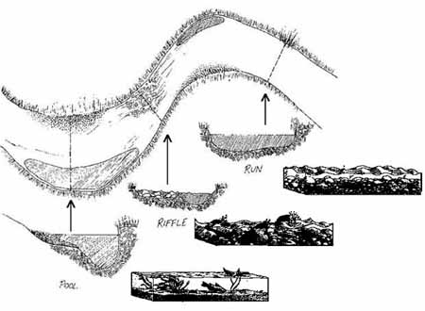
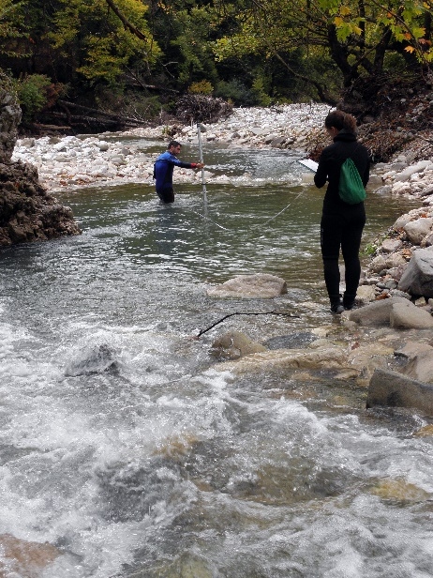
A mesoscale approach for the selection of the study reaches
Habitat mapping for the selection of the representative study reaches in a segment of 1.5 km length
Identification of several types of hydromorphological units, (i.e. pools, runs, riffles, glides, rapids) noting their location and extent, and measuring their physical attributes (width, mean depth)

Slide 5
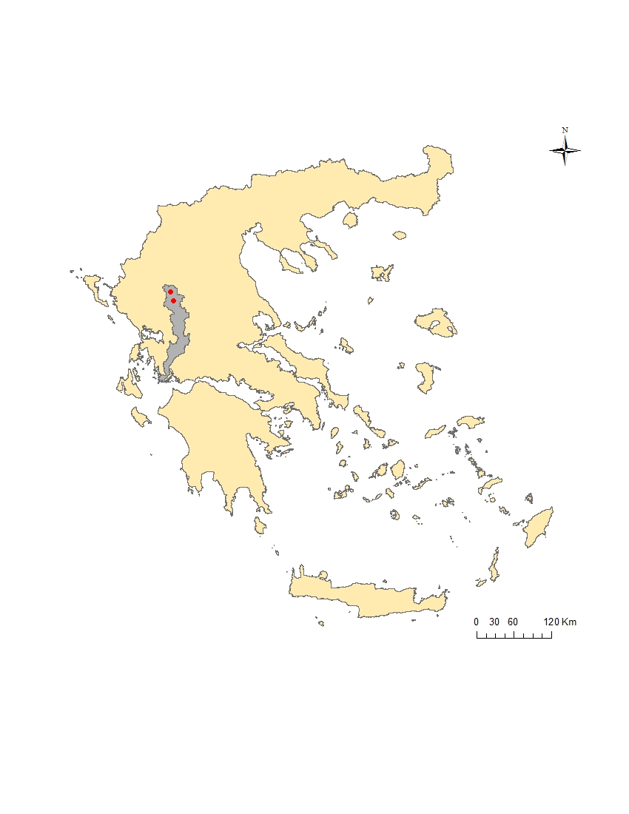
Study sites
Athens

Slide 6
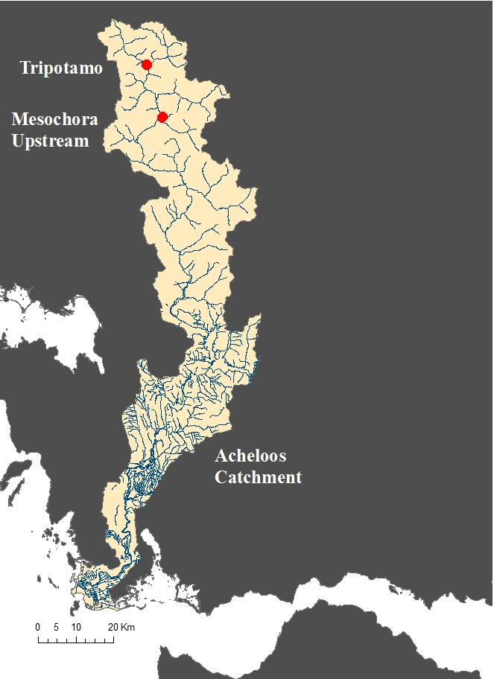
Study sites
Location:
Mountainous part of the upper Acheloos River Basin
Why these two sites?
relatively undisturbed conditions
intense debate about the construction of small hydroelectric plants in montane rivers
Main characteristics:
Summer flows are ranging from 2 to 5 m³/sec based on past measurements of Public Power Corporation of Greece.
mean elevation: 1100 m a.s.l.
average slope: 2.5 %

Slide 7
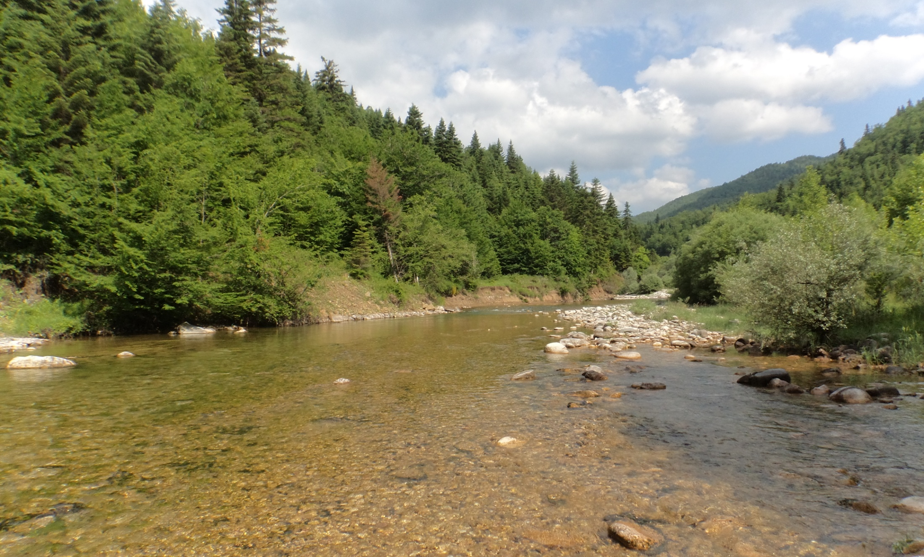
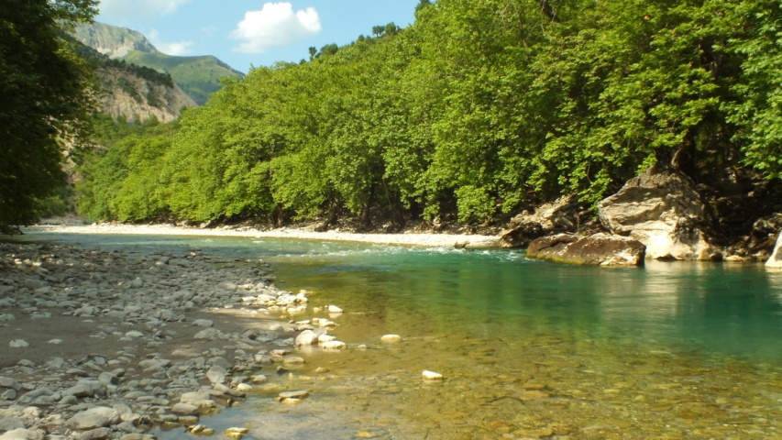
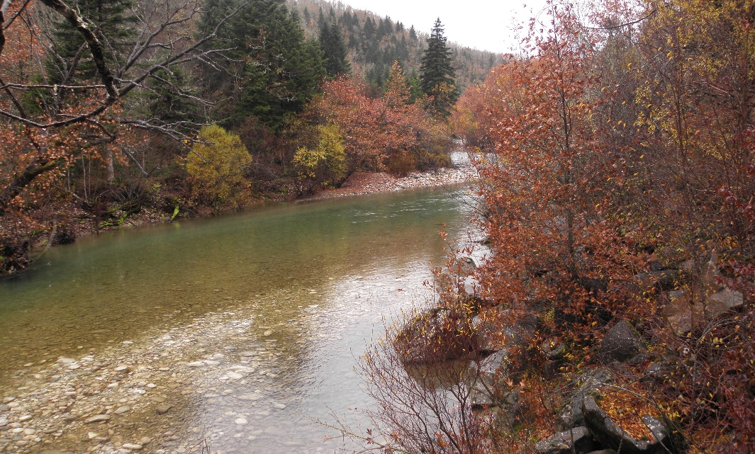
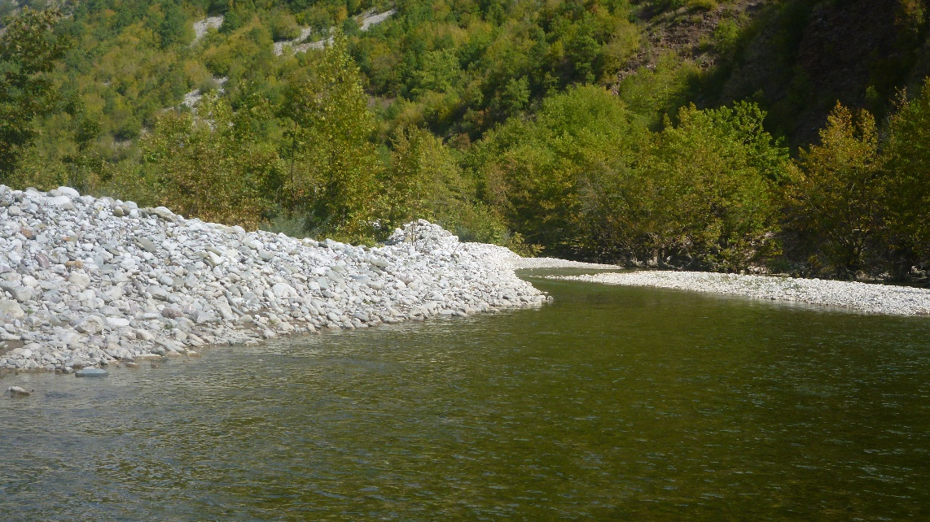
Tripotamo
Mesochora upstream

Slide 8
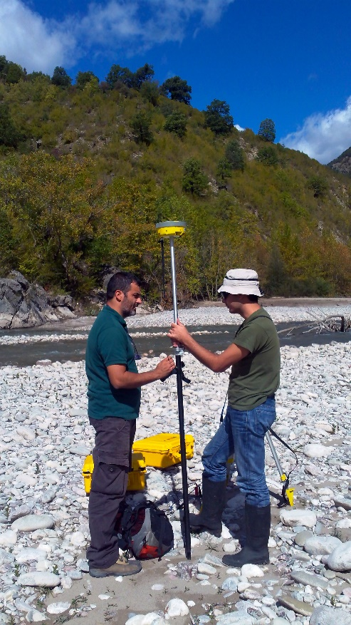
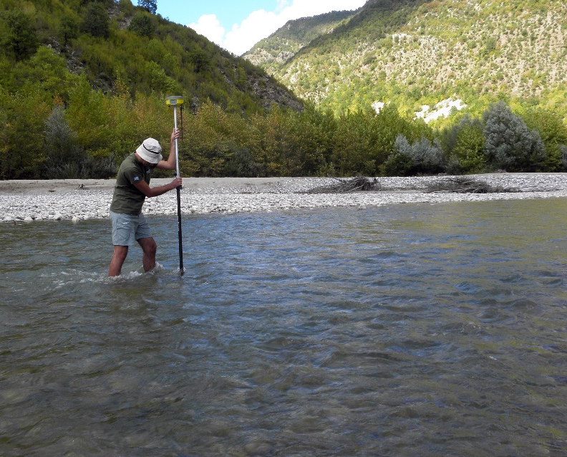
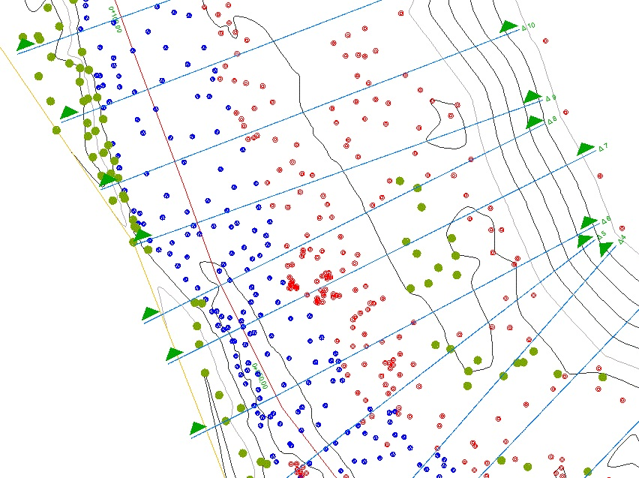
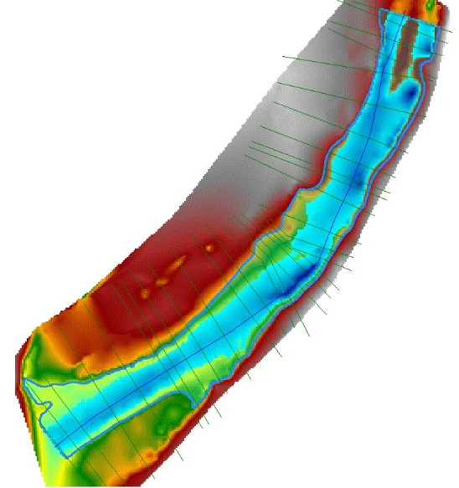
A detailed topographic survey was made to create a digital elevation model (DEM)
 | Substrate type | Size (mm)
1 | Vegetation | -
2 | Silt (Mud) | <0.06
3 | Sand | 0.06-2
4 | Gravel | 8 - 64
5 | Cobble | 64-264
6 | Boulder | >264

Slide 9
A short description of the method
River flows
Hydraulic Model
Bed
Cross
roughness
sections
HEC RAS
Manning’s N
Depth
Suitability
Velocity
GIS layer
curves
GIS layer
Suitability Maps
Weighted Usable Area
(WUA)

Slide 10
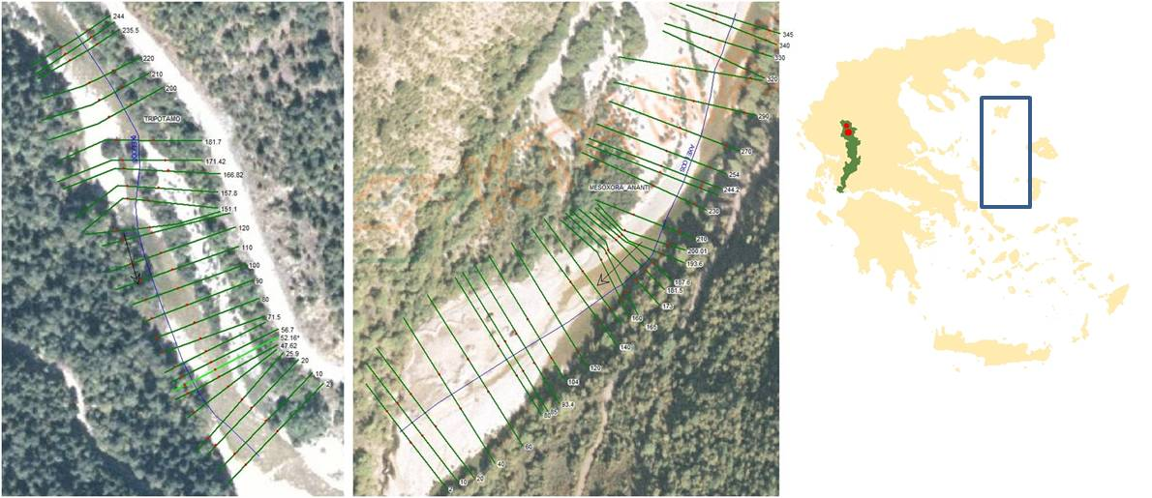
Cross sections
Tripotamo
27 transects within a 246 m reach
Mesochora Upstream
31 transects within a 348 m reach
(covering the channel and floodplain)

Slide 11
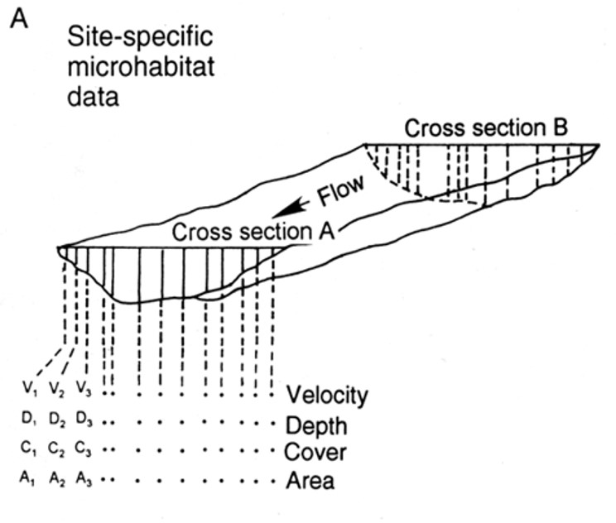
Every cross-section was divided in sub-sections (cells) in the HEC-RAS,
then the model calculates the mean velocity at each cell
(at a given river flow and WSE)

Slide 12
Mesochora Upstream
(A) Simulated Depth results (m) Mesochora Upstream
Q | 1 (m³/sec) | 8 (m³/sec) | 30 (m³/sec)
HEC - RAS
(B) Simulated Velocity results (m/sec) Mesochora Upstream
Q | 1 (m³/sec) | 8 (m³/sec) | 30 (m³/sec)
HEC - RAS

Slide 13
Tripotamo
(A) Simulated Depth results (m) Tripotamo
Q | 1 (m³/sec) | 10 (m³/sec) | 15 (m³/sec)
HEC - RAS
(B) Simulated Velocity results (m/sec) Tripotamo
Q | 1 (m³/sec) | 10 (m³/sec) | 15 (m³/sec)
HEC - RAS

Slide 14
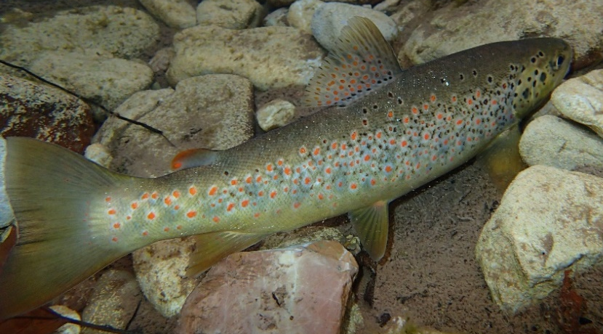
Depth and mean velocity were converted into their corresponding values of habitat suitability index using habitat suitability curves extracted from former studies of trout habitat (Boove 1978)

Slide 15
Maps of habitat suitability (HSI) with 4 suitability classes:
(C) Habitat Suitability Index
Q | 1 (m³/sec) | 10 (m³/sec) | 15 (m³/sec)
TRIPOTAMO
 | 1 (m³/sec) | 8 (m³/sec) | 30 (m³/sec)
MESOCHORA UPSTREAM
the aggregated Habitat Suitability Index (HSI) was calculated for each cell

Slide 16
Results
Weighted Usable area (WUA)
WUA = Σ(Ai× Ci)
Ai: is the area of a cell i
Ci : the aggregated HSI value of the cell i
Given the present curves, we could estimate that the optimum flow corresponds to 1 m³/s in Tripotamo, and 8 m³/s in Mesochora
(m ² )
(m ² )

Slide 17
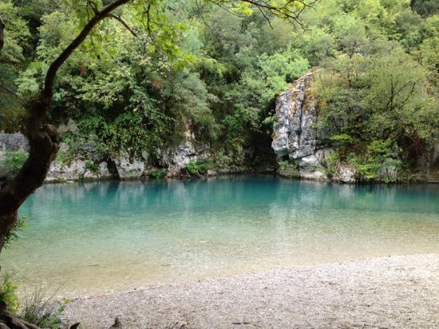
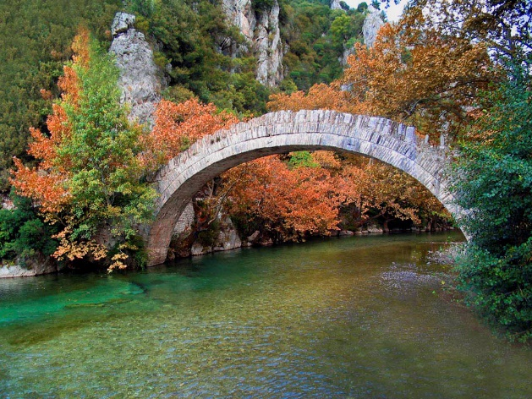
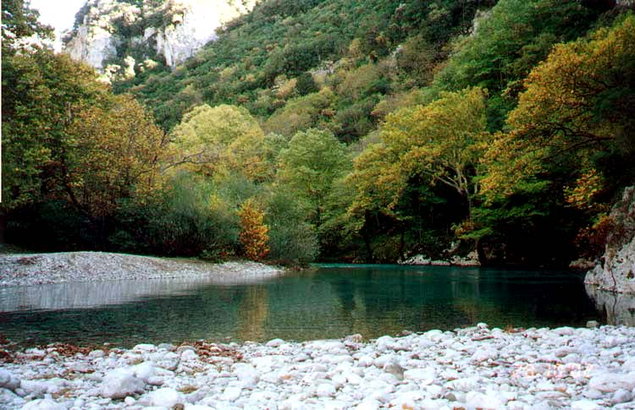
Conclusions
further data collection will be necessary to extract reliable conclusions about the variation of river habitats at both low and high flows
local fish species habitat suitability curves must be developed
(and this has already begun during preliminary snorkeling surveys)
further hydrological analysis to determine the relevance of these flows in the frame of the time series of natural flow regime at each site
further analysis and validation of the models

Slide 18
Thank you for your attention
Hellenic Center for Marine Research
Institute of Marine Biological Resources and Inland Waters
Website: http://imbriw.hcmr.gr/en/
http://www.ecoflow.gr/en/

